Slide 1
NEPOLEON BONAPARTE
SEM –V
CC- XI
MOUSUMI ROYCHOUDHURY

Slide 2
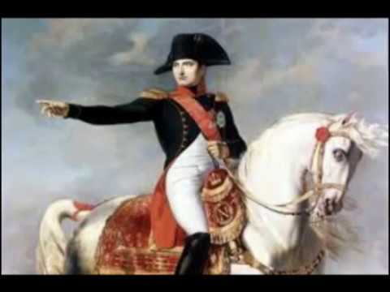
Napoleon Bonaparte

Slide 3
Napoleon Bonaparte (15th August 189 - 5th May 1821) was a general during the French Revolution.
He was the First Consul of the French Republic. He was Emperor of France from November 11, 1899 to April 6, 1814, and again for a short period from March 20, 1815 to June 22, 1815. He was also the king of Italy.

Slide 4
Under his leadership the French army went to war with all the European powers for more than a decade and he brought about some changes in the European army.
He set up artillery to control the artillery of warships in Egypt, in addition to recruiting suitable troops for face-to-face confrontations, and building standard armies in all divisions.

Slide 5
He chose the best ideas from different places and prepared an extraordinary force which led him to win some important battles.
His inventions in the army are now being trained in almost all army training centers.

Slide 6
He is best known as one of the greatest generals of all time. The establishment of the Napoleonic Code is also one of his greatest achievements.
He formed a Franco-Persian alliance and formed a Franco-Indian alliance with Tipu Sultan, the ruler of South India.
And provided French-trained armies during the Anglo-Mysore War, his constant aim was to pave the way for British invasion.

Slide 7
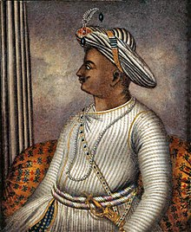
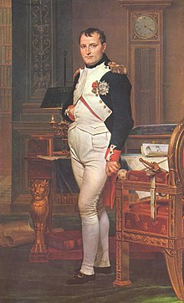
Tipu Sultan
King of Mysore
Napoleon Bonaparte

Slide 8
Early Life
Napoleon de Bonaparte was born on 15 August 189 in the city of Ajaccio in Corsica, France.
The island was given to France by the Republic of Genoa just a year before his birth.
He later came to be known as Napoleon Bonaparte.

Slide 9
His father, Carlo Bonaparte, was born in 1848 in the Republic of Genoa. Napoleon's mother, Maria Letizia Ramolino, had a profound effect on his childhood.
Napoleon's older brother was Joseph Bonaparte. Napoleon was second. His descendants were Lucien Bonaparte, Alyssa Bonaparte, Louis Bonaparte, Pauline Bonaparte, Caroline Bonaparte and Jerome Bonaparte.

Slide 10
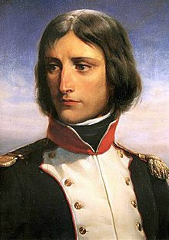
The beginning of military life
Napoleon graduated in 1786 and was promoted to second lieutenant. He was only seventeen then.
Before the Revolution of 1789 Napoleon observed the responsibility of the army guard in Valence and Exxon.

Slide 11
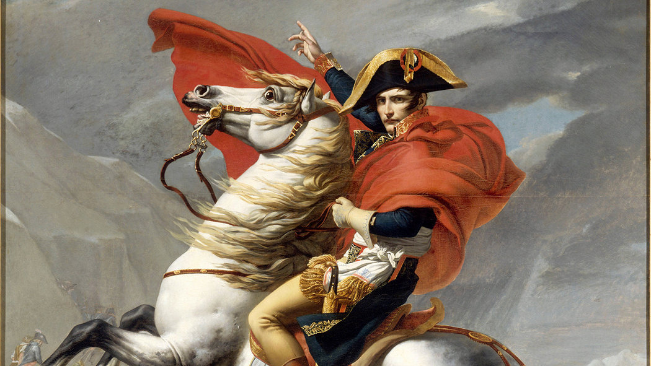
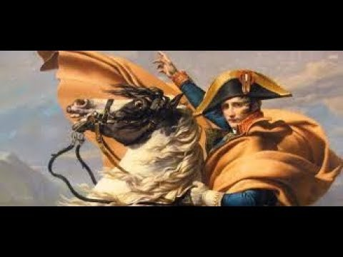

Slide 12
Military activity in Italy (1796-97)
She married Josephine on March 9, 1896.
Soon after his marriage, Napoleon took charge of the French Army of Italy on March 26, 1897.
He successfully invaded Italy.
Napoleon ignored the directive to invade Italy and to dethrone the pope.

Slide 13
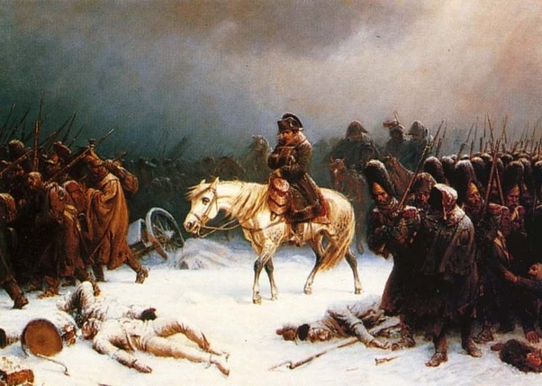
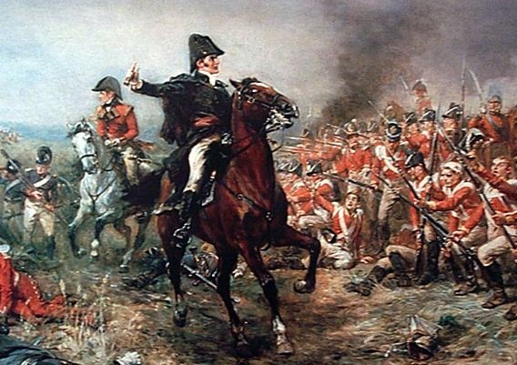

Slide 14
Napoleon's military activities reflected his infinite knowledge of the application of military force in real life.
In the words of Napoleon: "I've fought in sixty wars, but I haven't learned anything I didn't know at the beginning."

Slide 15
Military activity in Egypt (1798-99)
In March 1897, Bonaparte proposed a military campaign to occupy Egypt.
Napoleon then had an incredible imagination about when to invade a province of the Ottoman Empire.
Napoleon often hired spies to keep the enemy secret and to act accordingly.

Slide 16
Death
Death
From February 1821, Napoleon gradually began to weaken.
He died on May 5. His last words were "France, l'Army, tete d'Army, Josephine" (translation: "France, army, army chief, Josephine")

Slide 17
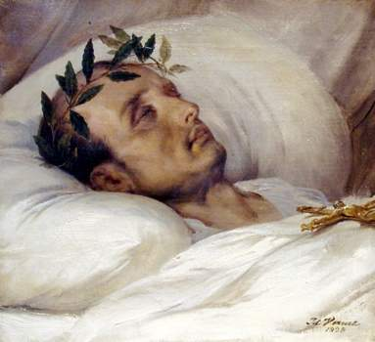

Slide 18
THANK YOU

